Slide 1
Y8 Challenge Task
IMAGE DETECTIVES – WELL IMAGINE THAT

Slide 2
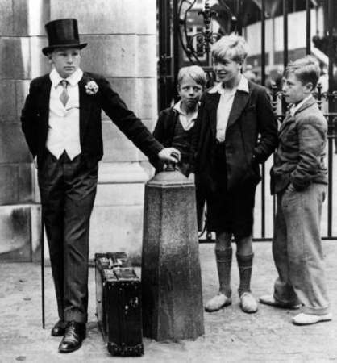
Image Detective
Describe the scene
Aspirations of the people
How do they feel about each other?

Slide 3
Extension:
If writing a book based on the picture – what genre would it be?
What would the title be?
What style of writing would you use?
Write an opening to the book.

